Slide 1
Revolutionizing Recruitment in India
AI-Powered Conversational Hiring Platform
Connecting millions of job seekers with their ideal employers through intelligent conversations
Making hiring human, efficient, and accessible for India's diverse workforce
Kushagra Jajodia
(December 2025)

Slide 2
The Problem
For Job Seekers
  Resumes reduce candidates to keywords, missing real skills and potential
  Language barriers and formatting requirements exclude capable talent
  Endless applications with no feedback lead to wasted effort and ghosting
  No access to personalised career guidance or mentor in the market
For Employers
  High volume of irrelevant applications overwhelms recruiters
  Cannot assess communication, motivation and cultural fit early
  Passive job boards slow hiring and miss quality candidates
  Manual screening drivers up costs and delays business outcomes

Slide 3
The Solution
2 conversational AI agents (name tbd), 1 for the candidate and the other for the employer that replaces resumes with natural conversations in multiple languages
For Job Seekers
  Chat in Hindi, English, Tamil, Telugu, Bengali, and more
  AI understands skills, experience, and aspirations, cultural fit through conversation
  Get matched with relevant jobs automatically
  Practice interviews with AI feedback in your language
  Works on basic smartphones with WhatsApp integration
For Employers
  AI conducts initial screening conversations at scale
  Get pre-qualified candidates ranked by fit
  Reduce time-to-hire by 70%
  Access to more relevant candidates quicker and cheaper than job board listings or human headhunters

Slide 4
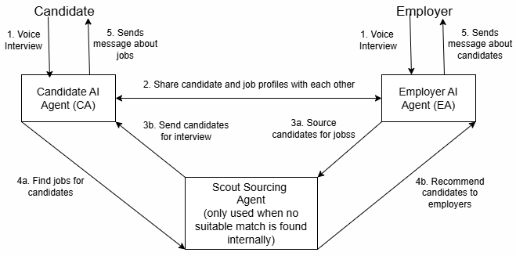
How it works

Slide 5
How it works
1. Voice Interview
Candidates speak directly to CA. He conducts a voice interview to understand their skills, experience, and career goals.
Hiring Managers speak directly to EA. She conducts a voice interview to understand the open role, requirements, and ideal candidate profile.
2. The Agent Collaboration
After a successful voice interview, both the agents share a one page summary with each other to see if they have matching roles for the candidates.
3. The Scout Layer
Sometimes the agents won’t have an immediate match in the database, this is when they call Scout.
When EA has an opening but no internal candidates, Scout searches LinkedIn via x-ray search to find profiles which match the job description and sends them to the CA to initiate contact with the candidates
4. The Scout Layer
CA has a stellar candidate but no internal roles. Scout looks for roles on LinkedIn and sends the leads to the EA. She then initiates contact with the hiring managers at those companies.
5. Output
Both the agents send messages to candidates and employers about relevant job opening and candidates respectively.

Slide 6
Why we’ll win
Built for India
  Multilingual AI- Support for 10+ Indian languages from day one
  Mobile First- Compatible with smartphones with WhatsApp integration
  Low Bandwidth- Optimised for 2G/3G networks
  Cultural Context- Understands Indian education system, job roles, and preferences
Superior Technology
  Advanced Natural Language training on Indian English and vernacular languages
  Voice-enabled for low literacy populations
  Smart matching algorithm considers location, salary, skills, and growth potential
  Bias-free screening focused on capabilities, not credentials
Revenue Model
  Subscription Model- ₹5,000 - ₹50,000/month based on company size and hiring volume
  Pay per Hire- 10% of annual CTC or a fixed amount per successful hire (flexible for SMEs)
  Premium Features- Advanced analytics, employer branding, skill assessments
  Freemium for Job Seekers: Free matching + premium services (resume building, interview preparation etc.)

